Slide 1
Identity Technologies Landscape Overview
Justin Richer
October 2011
Notes:
Vulnerabilities
Use cases
Non-use cases

Slide 2
What do you mean by “identity”?
Authentication
Authorization
Profile information
Verifiable claims
Personal data
Biometrics
Notes:
Identity means different things to different people
a) people who are part of an enterprise, such as employees
b) people who receive services from an enterprise, such as customers, or
members of other organizations with which the enterprise interacts
c) people, such as criminal suspects or members of adversary forces, about
whom information is collected.

Slide 3
Authentication
Are you who you claim to be?
How do you prove that?

Slide 4
Authorization
Are you allowed to do what you’re asking to do?
Who said so?
How can I be sure?

Slide 5
Profile information
What bits of info does the system know about the person using it?
What level of trust does the system need about these bits?

Slide 6
Claims
How sure can I be about things said about you?
Who said so?

Slide 7
Personal data
What other bits of data do you carry with you?
Who said those bits and how do I verify that?
How much do I care?

Slide 8
Biometrics
Physically identifying people
Face recognition
Fingerprints
Voice recognition
Positive identification of unknown entities
Often not for credentials

Slide 9
Distributed, Federated, or Local?
Distributed
Don’t know ahead of time who all the players are
Internet collaboration
Federated
Know who the players are, but not what exactly they’ll be doing
Cross-organizational collaboration
Local
Control everything within a single stack
Within-app (username/pass)
Within-enterprise (LDAP)
Notes:
There are different forms of identity, they often work together

Slide 10
Today’s topic
Distributed and Federated technologies
Connecting across boundaries
Local ID is a separate problem space
This is not exhaustive coverage
This is a fast-moving space

Slide 11
We’re not covering
Per-app Username/password
Does not scale
Aggravating user experience
Account management nightmare
LDAP
Cumbersome, old, not available over HTTP
Exposes secrets to client applications
SecurID or other hardware tokens
Effectively a strong, hardware-backed username/password
Active Directory (NTLM)
Requires binding to Microsoft Windows Domain
Single-point SSO
Works only within a single trust domain

Slide 12
The Technology

Slide 13
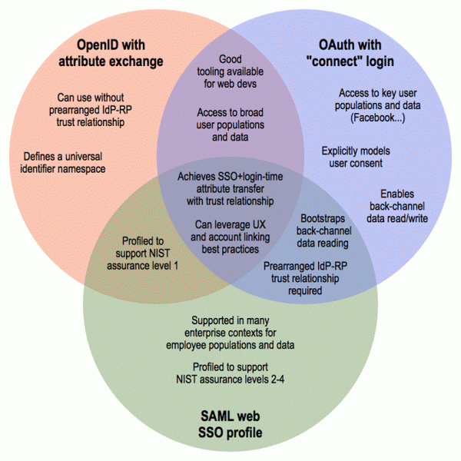
The Venn of Federated Identity
From http://blogs.forrester.com/eve_maler/11-02-03-openid_successful_failures_and_new_federated_identity_options

Slide 14



The Triangle of Nonlocal Auth
End User
(and user agent)
Service Provider
(“Relying Party”: RP)
Identity Provider
(IdP)

Slide 15
OpenID 2.0
Fully distributed, scales to internet size
Can work without prearranged IdP/RP relationship
Designed around per-user trust decisions
Can use whitelists/blacklists for SSO
Provides authentication
Extensible to include profiles and claims
Uses front channel for passing data
Provides base-level assurance
RP has to really trust the IdP
Roughly equivalent to email-backed username/password pairs

Slide 16
SAML (Web SSO)
Requires federation of central authorities
Preregistration of trust, pairwise
Can scale to small numbers of organizations
Higher levels of assurance
Configured certificates for signing
Can handle authentication, authorization, claims, and some profile
All passed as signed claims
Formats must be agreed upon between parties
Wide deployment in enterprise environments
Notes:
SAML is a sophisticated server sending a sophisticated document to a sophisticated client.

Slide 17
OAuth-style Directed ID
Strong tie to the IdP
Preregistration
Implicit full trust of IdP
Profile bits packed in for free
Uses back channel for passing data
Already used on the web
Twitter sign in
Facebook Connect
Dumbfoundingly huge adoption
Millions of client sites on the public web

Slide 18
Public Key Infrastructure (PKI)
High levels of assurance
Uses signatures and encryption to protect data
No secrets passed over the wire
Requires central authority to be usable
Reality: hundreds of central authorities
Eg, global SSL certificate authorities
No web-of-trust model has yet succeeded
Provides strong authentication
Best for long-lived information
But needs to be tied to other things for authorization, profiles, and claims

Slide 19
Common Access Card / Personal Identity Verification
PKI with a hard token
User certificates stored on hardware cards instead of on host system
Requires special hardware and software on host systems
Provides authentication
Basic authorization, profiles, and claims
Needs to be used in conjunction with something else for additional information
Relies on central authority
If the authority doesn’t like you, you’re out of luck

Slide 20
BrowserID
PKI built into the browser
Developed by Mozilla
Local keys stored inside of compliant browser
Asymmetrical token signing
Uses JWT (JSON Web Tokens)
Introspection endpoint
Client can verify signature of request without doing PKI signature calculations directly

Slide 21
Simple Cloud Identity Management (SCIM)
RESTful API for identity
Built on PortableContacts schema
Not a full authentication protocol
Account and profile data provisioning
Basic flow for getting/setting profile information
Notes:
http://www.simplecloud.info/

Slide 22
The (near) future

Slide 23
The Identity Singularity*
The Venn bubbles are collapsing
Open, distributed technology is moving toward supporting higher assurance
Enterprise technology is moving toward supporting more dynamic use
Working systems are being defined now
It’s a real need across industries
*Term borrowed from Eve Maler http://www.xmlgrrl.com/

Slide 24
SAML Getting Simpler
New deployment technologies
Fedlet
Shibboleth
OpenSSO (Oracle), ADSF (Microsoft)
Still requires heavyweight XML processing

Slide 25
OpenID Getting Stronger
Strong Artifact Binding
Borrowed from SAML
Directed identity
Federated use cases
Levels of trust
Including dynamic distributed discovery

Slide 26
OAuth Getting More Features
OAuth2 flexibility
Profiles for different deployments
Standardized identity bindings
Advanced authorization capabilities
User-Managed Access (UMA)

Slide 27
The new kid: OpenID Connect
Built on OAuth 2.0
Uses back-channel binding for data flow
Can be higher-assurance
Preregistration, strong binding
Certificate-level verification between servers
Can be ad-hoc
Dynamic registration
Arbitrary IdP for users is possible

Slide 28
Who do you trust?

Slide 29
User trust models
Centralized trust
“We’ll make all of your trust decisions for you, and you can let us know of any exceptions”
Only works while central knowledge reflects reality
Trust on First Use: TOFU
“You’ve trusted this thing before, and I’m pretty sure it’s the same one as last time”
Allows systems to scale based on user decisions
Notes:
One dimension of trust model

Slide 30
Layers of user trust
Security must be usable by regular people
We need multiple models, together
It’s a continuum
Let organizations decide:
What organizations/sites to trust automatically
Who to sue if something goes wrong
Who to block completely
Let users decide:
If they trust things the organization is silent about
(It’s easy to forget about this one)

Slide 31
It should look like this:
Whitelist
Trusted partners, business contracts, customer organizations, trust frameworks
Graylist
User-based trust decisions
Follow TOFU model, keep logs
Blacklist
Very bad sites we don’t
want to deal with, ever

Slide 32
This is who builds it:
Whitelist
Trusted partners, business contracts, customer organizations, trust frameworks
Graylist
User-based trust decisions
Follow TOFU model, keep logs
Organizations decide these
End-users decide these
Blacklist
Very bad sites we don’t
want to deal with, ever
Notes:
Organizational support and logging

Slide 33
The Future at MITRE

Slide 34
Oracle Identity Manager
SAML 2.0 Compliant system
Can support enterprise-scale applications
Can centralize authorization decisions
And export them within a federation
Requires significant setup and support from authorities running the IdP
For users, RPs, other IdPs, and others

Slide 35
OAuth Expertise
Deep deployment experience with OAuth
Handshake
Yo
MyMII 2.0
Growing deployment experience with OAuth2
PuSHEE
Profile server

Slide 36
Usable Distributed Identity MSR
October 2011-September 2012
An OpenID Connect endpoint for MITRE
Working with community and industry
Certifying our deployment as a trusted system
Still supporting OpenID 2.0 as transitional technology
Moving legacy systems over as appropriate (Handshake, Yo)

Slide 37
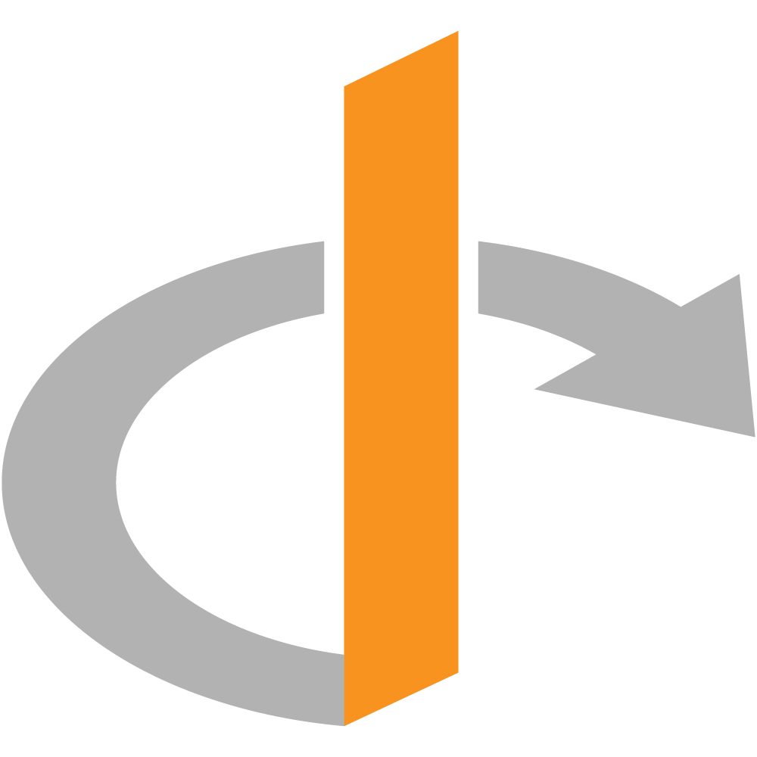


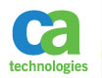
MITREid OpenID Architecture
External OP
Database
DMZ
Corporate Firewall
Intranet
Internal OP
User Data
SiteMinder SSO
Notes:
Split DNS between internal and external OPs: same address goes to different servers
Database is enclaved, only allows limited inbound connections

Slide 38
Where We Should Be Going
Connect across these platforms
Our users should not have separate accounts
Expose same identities with different interfaces
Security analysis of these platforms
Interoperate with what’s out there already
Vendors should support at least one of these technologies out of the box
Stop building proprietary one-off integrations

Slide 39
Thank You
jricher@mitre.org

